Slide 1
S Block Elements
Alkaline earth metals
Made By- Manas Mahajan

Slide 2
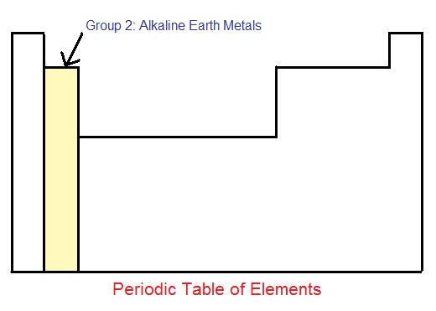

Slide 3
What are alkaline earth metals?
The group 2 elements of the periodic table are known as the alkaline earth metals. The alkaline earth metals contain:
 |  | El conf
Beryllium | Be | [He]2s²
Magnesium | Mg | [Ne]3s²
Calcium | Ca | [Ar]4s²
Strontium | Sr | [Kr]5s²
Barium | Ba | [Xe]6s²
Radium | Ra | [Rn]7s²

Slide 4
Why this name?
The oxides of these six metals are basic (alkaline), especially when combined with water. "Earth" is said as it is found in the earth crust. Hence, the term "alkali earths" is often used to describe these elements.

Slide 5
Electronic Configuration
There are four principle orbitals (s, p, d, and f) which are filled according to the energy level and valence electrons of the element. The s-orbital can hold 2 electrons, and the other three orbitals can hold up to 6, 10, and 14 electrons, respectively. The s-orbital primarily denotes group 1 or group 2 elements, the p-orbital denotes group 13, 14, 15, 16, 17, or 18 elements, and the f-orbital denotes the Lanthanides and Actinides group.
The electron configuration of transition metals is special in the sense that they can be found in numerous oxidation states.

Slide 6
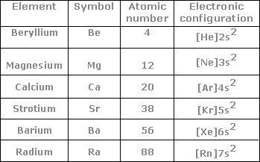
Electronic configuration of alkaline earth metals.
These elements have two electrons in the valence shell of their atoms, preceded by the noble gas configuration. Their general configuration is written as [Noble gas] ns² where 'n' represents the valence shell.

Slide 8
Atomic radius.
What is atomic radius?
It is half of the distance between the centers of two bonded atoms.
What is ionic radius?
Ionic radius is the half of the distance between two opposite ions in an ionic bond i.e. half of the ionic bond length.

Slide 9
The atomic and ionic radii of elements of group 2 or any group increases down the group as it is directly proportional to the ‘n’ i.e. the no. of shells.
The atomic and ionic radii decrease along the period due to increased nuclear charge i.e. the no. of electrons increase for the same value of n. Thus the electrons are more closely bonded to the nucleus. And hence the size of alkaline earth metals is comparitively smaller than respective alkali metal.
On moving down the group, the radii increase due to gradual increase in the number of the shells and the screening effect.
Physical Property Be Mg Ca Sr Ba Ra
Atomic Radius (pm) 112 160 197 215 222 --
Ionic Radius (pm) 27 72 100 118 135 148

Slide 10
Ionization Enthalpies
What is ionization enthalpy?
It is the minimum required energy change to remove loosely bonded electron from outermost shell of isolated gaseous atom.
I.P1 is the ionization enthalpy to remove the last one electron from the atom.
I.P2 is the ionization enthaply to remove the second electron from the atom and so on..
The successive ionization enthapies are greater since it is more difficult to remove an electron from a positively charged ion than from a nuetral atom.
This process is endothermic that is we have to supply energy to remove the electron.

Slide 12
Hydration Enthalpy
When ionic compound is dissolved in water or in a polar solvent then different ions of the compound get separated and will get surrounded by polar solvent molecules. This process is known as solvation or hydration and the energy change in this process is known as hydration enthalpy.

Slide 13
Physical properties
Appearance: These metals are silvery white and lustrous and harder than group 1 elements.
Melting and boiling points: The alkaline earth metals have a smaller size than their corresponding alkali metals. Thus the electrons are more closely bonded to the nuclues and hence difficult to break the bonds and hence the melting and boiling points are a bit higher.
In case of some elements of this group,they impart colours in the flame. The reason behind this is that the energy supplied by the flame excites the electrons to higher energy levels. And when they come down to ground state , the excess energy is emitted in the form of light. For example calcium, strontium and Barium impart brick red,crimson and apple green colours respectively in the flame.

Slide 14
The electrons in berullium and magnesium are too strongly bound to get excited by the flame.

Slide 15
Chemical Properties

Slide 16
Reactions with water:
When added to water, the first alkaline earth metal (Beryllium) is totally unreactive, and doesn't even react with steam. Then as you move down the group, the reactions become increasingly vigourous.
As an example, the following reaction takes place between magnesium and water, an alkali earth metalhydroxide and hydrogen gas is produced. Magnesium can be substituted for any group 2 metal however.
Mg_{(s)} + H₂O_{(l)} → Mg(OH)_{2 (aq)} + H₂
When magnesium is reacted with steam, it is even more vigourous, and instead of a hydroxide, an oxide is produced as well as hydrogen gas.
Mg_{(s)} + H₂O_{(g)} → MgO_{(s)} + H_{2 (g)}

Slide 17
Reactivity towards acids:
The alkaline earth metals react with acids to liberate dihydrogen gas.
Reducing nature:
These are strong reducing agents but weaker than the first group elements. They have a large negative value of reduction potentials.

Slide 18
Solutions in liquid ammonia:
These elements dissolve in liquid ammonia to give deep blue black solutions forming ammoniated ions.

Slide 19
Oxides
The oxides of alkaline earth metals have the general formula MO and are basic. They are normally prepared by heating the hydroxide or carbonate to release carbon dioxide gas. They have high lattice enthalpies and melting points. Peroxides, MO₂, are known for all these elements except beryllium, as the Be²⁺ cation is too small to accommodate the peroxide anion.
Hydroxides
Calcium, strontium and barium oxides react with water to form hydroxides:
CaO(s) + H₂O(l) ® Ca(OH)₂(s)
Calcium hydroxide is known as slaked lime. It is sparingly soluble in water and the resulting mildly alkaline solution is known as lime water which is used to test for the acidic gas carbon dioxide.
Halides
The Group 2 halides are normally found in the hydrated form. They are all ionic except beryllium chloride. Anhydrous calcium chloride has such a strong affinity for water it is used as a drying agent.

Slide 20
Uses of alkaline earth metals.
Beryllium: It is used in the manufacture of alloys; which is used in preparation of high springs.Metallic beryllium is used for making windows X-ray tubes.
Magnesium: it is used in flash powders and bulbs, incendiary bombs and signals. Magnesium hydroxide in water is used as an antacid in medicine. Magnesium carbonate is an ingredient in toothpaste.
Calcium: It is used in the extraction of metals from oxides which are difficult to reduce with carbon. Calcium and barium are used to remove air from vaccum tubes.
Radium: Radium salts are used in radiotherapy,for treatment of cancer.

Slide 21
Cancer
Cancer is the uncontrolled growth of abnormal mutant cells within the body. These abnormal cells divide at such a rate that their growth far exceeds that of normal cells. Thus, over time, the cancerous cells will eventually dominate the natural tissues of the organism, rendering biological processes unable to be completed. Symptoms include fatigue, chills, fever, feelings of malaise, and unexplainable weight loss.
Radiation Therapy
Radiation therapy is still a popular alternative for treating cases of cancer. Radiation therapy uses high-energy radioactive waves to locally target the cancerous tissue. According to the National Cancer Institute, the applied radiation damages the genetic material of the cancerous cells, making it impossible for them to continue dividiing.

Slide 22
General Characteristics of Compounds of the Alkaline Earth Metals

Slide 23
Dipositive oxidation state (M²⁺) is the predominant valence of Group 2 elements.
Compounds formed are ionic but less ionic than corresponding compounds of alkali earth metals (due to increased nuclear charge and smaller size).
Oxides and other compounds of beryllium and magnesium are more covalent than those formed by other members.

Slide 24
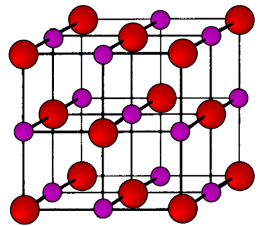
Oxides and Hydroxides
Alkaline earth metals burn in oxygen to form the monoxide , MO which, except for BeO, have rock-salt structure (structure of NaCl).
Enthalpies of formation of theses oxides are high and they hence have high thermal stability.

Slide 25
All oxides apart from BeO are ionic and basic in nature. They react with water to give hydroxides that are sparingly soluble.
MO + H₂O M(OH)₂
Solubility, thermal stability and basic character of hydroxides increases with increasing atomic number from Mg(OH)₂ to Ba(OH)₂.

Slide 26
Why solubility increases down the group?
Anions being common, the cationic radius influences the lattice enthalpy. Since lattice enthalpy decreases much more than hydration enthalpy with increasing ionic size, there is an increase in solubility.

Slide 27
Amphoteric Beryllium Hydroxide
Berrylium Hydroxide is amphoteric in nature as it reacts with both acids and bases –
Be(OH)₂ + 2OH⁻ [Be(OH)₄]²⁻ Beryllate Ion
Be(OH)₂ + 2HCl + 2H₂O [Be(OH)₄]Cl₂
Beryllium Oxide is essentially covalent in nature.

Slide 28
Halides
All alkaline earth metals halides are ionic in nature apart from Beryllium halides.
Tendency to form halide hydrates gradually decreases down the group.
Fluorides are relatively less soluble than chlorides owing to high lattice energies.

Slide 29
Beryllium Halides
They are covalent in nature and soluble in organic solvents.
It has a chain structure as shown above.

Slide 30
Salts of Oxoacids
Carbonates : Insoluble in water and precipitated by addition of sodium/ammonium carbonate solution to solution of soluble salt. Thermal stability increases with increasing cationic size.
Sulphates : White solids and stable to heat. Solubility decreases from CSO₄ to BaSO₄.

Slide 31
Why solubility of carbonates and sulphates decrease down the group?
Size of anions are larger than cations, the lattice enthalpy will remain constant within a group. Since hydration enthalpy decreases down a group, solubility also decreases.

Slide 32
Nitrates : Made by dissolution of carbonates in dilute nitric acid. There is a decreasing tendency to form hydrates with increasing size and decreasing hydration enthalpy.
Nitrates decompose on heating to give the oxide like lithium nitrate.
2M(NO₃)₂ 2MO + 4NO₂ + O₂

Slide 33
Anomalous Behavior of Beryllium
Exceptionally small atomic and ionic sizes. High ionization enthalpy and small size leads it to form largely covalent compounds.
Oxides and hydroxides are amphoteric in nature.
Does not exhibit coordination number more than 4 as in its valence shell there are only 4 orbitals.

Slide 34
Diagonal Relationship between Beryllium and Aluminium
Like Aluminium, beryllium is not readily attacked by acids because of presence of an oxide film on the metal’s surface.
Beryllium hydroxide dissolves in excess of alkali to give beryllate ion [Be(OH₄)²⁻] , just like aluminium.

Slide 35
Chlorides of aluminium and beryllium have Cl⁻ bridged chloride structure in vapour phase. Both are soluble in organic solvents and are strong Lewis acids. They are used as Friedel Craft catalysts.
Beryllium and aluminium ions have strong tendency to form complexes, BeF₄²⁻ and AlF₆³⁻.

Slide 36
CALCIUM COMPOUNDS
I. Shivkumar Sharma
XIth science

Slide 37
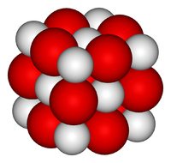
Calcium oxide
Calcium oxide (CaO), commonly known as quicklime or burnt lime, is a widely used chemical compound. It is a white, caustic, alkaline crystalline solid at room temperature.

Slide 38
Preparation of CaO
Calcium oxide is usually made by the thermal decomposition of materials such as limestone, that contain calcium carbonate (CaCO₃; mineral calcite) in a lime kiln. This is accomplished by heating the material to above 825 °C (1,517 °F), a process called calcination or lime-burning, to liberate a molecule of carbon dioxide (CO₂); leaving quicklime.
CaCO3 CaO + CO2

Slide 39
Uses of CaO
When quicklime is heated to 2,400 °C (4,350 °F), it emits an intense glow. This form of illumination is known as a limelight, and was used broadly in theatrical productions prior to the invention of electric lighting.
Calcium Oxide is also a key ingredient for the process of making cement.

Slide 40
It is used in the manufacture of sodium carbonate from caustic soda.
Used for purification of sugar

Slide 41
Precautions to be taken with CaO
Due to the vigorous reaction of quicklime with water, quicklime causes severe irritation when inhaled or placed in contact with moist skin or eyes. Inhalation may cause coughing, sneezing, labored breathing. It may then evolve into burns, abdominal pain, nausea and vomiting.
Although quicklime is not considered a fire hazard, its reaction with water can release enough heat to ignite combustible materials.

Slide 42
Calcium hydroxide Ca(OH)2
Calcium hydroxide, traditionally called slaked lime, is an inorganic compound with the chemical formula Ca(OH)₂. It is a colorless crystal or white powder and is obtained when calcium oxide (called lime or quicklime) is mixed, or "slaked" with water. It has many names including hydrated lime, builders lime, slack lime, cal, or pickling lime. It is of low toxicity. Calcium hydroxide is used in many applications, including food preparation.

Slide 43
Preparation
Calcium hydroxide is produced commercially by treating lime with water:
CaO + H₂O → Ca(OH)₂
In the laboratory it can be prepared by mixing an aqueous solutions of calcium chloride and sodium hydroxide.
CaCl2 + 2NaOH → Ca(OH)2 +2NaCl

Slide 44
Properties of Ca(OH)2
Reaction with CO2
Ca(OH)2 + CO2 → CaCO3 + H2O
Reaction with excess of CO2
CaCO3+CO2 +H2O→Ca(HCO₃)₂
Milk of lime reacts with chlorine to form hypochlorite, a constituent of bleaching powder.

Slide 45
Uses
It is used in the preparation of mortar, a building material.
It is used in white wash due to its disinfectant nature.
It is used in glass making, in tanning industry, for the preparation of bleaching powder and for purification of sugar

Slide 46
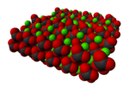
Calcium carbonate
Calcium carbonate is a chemical compound with the formula CaCO₃. It is a common substance found in rocks in all parts of the world, and is the main component of shells of marine organisms, snails, coal balls, pearls, and eggshells. Calcium carbonate is the active ingredient in agricultural lime, and is usually the principal cause of hard water. It is commonly used medicinally as a calcium supplement or as an antacid, but excessive consumption can be hazardous.

Slide 47
Preparation
The vast majority of calcium carbonate used in industry is extracted by mining or quarrying. Pure calcium carbonate (e.g. for food or pharmaceutical use), can be produced from a pure quarried source (usually marble).
Passing CO2 through slaked lime

Slide 48
Addition of calcium chloride to sodium carbonate
Addition of excess carbon dioxide should be avoided as it will lead to the formation of water soluble sodium hydrogen carbonate

Slide 49
Uses
Used as building block as marble
Used in manufacturing of quick lime
Specially precipitated calcium carbonate is used is manufacturing of high quality paper.
Used in manufacturing of antacids
Used as filler in cosmetics
Used as a constituent in chewing gum

Slide 50
Calcium sulphate (Plaster Of Paris)
P.O.P is obtained when gypsum is heated at 393 k
If heated above 393k no water of crystallization if left and compound known as “dead burnt plaster is obtained”
It has a remarkable property that if mixed with adequate quantity of water if sets hard in 5 – 15 minutes

Slide 51
Uses
P.O.P is mainly used in building industry
Used for curing fractures
Used by dentists to fill gaps in the teeth

Slide 52
Cement
Important building material, first introduced by Joseph Aspdin in England.
The raw materials used are lime stone and clay.
When clay and lime stone are strongly heated they react and form cement clinker and this is mixed with 2-3% of CaSo4 to form cement.

Slide 53
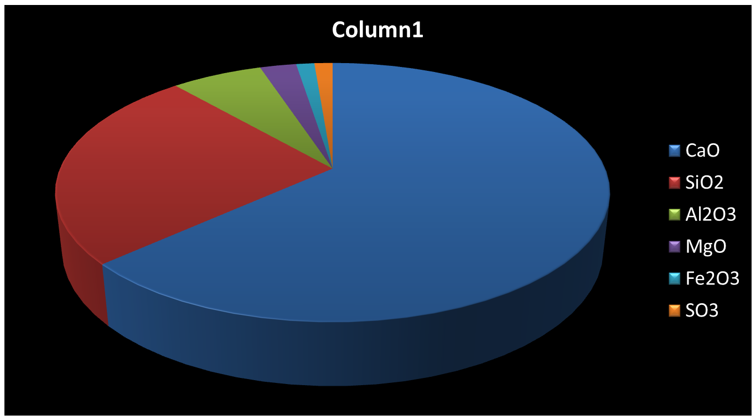
Composition of cement

Slide 54
Cement when added to water gives rise to a hard mass this is due to hydration of its constituents and rearrangement.
The reason for addition of gypsum is that is delays the process so that it gets to a perfect hardness.

Slide 55
Uses

Slide 56
Biological importance of calcium and magnesium
In an adult about 25g of Mg and 1200g of Ca are found.
The daily requirement for the body is about 200-300g.
All enzymes that use ATP for phosphate transfer use Mg as their co factor.
Chlorophyll also contains Mg which helps in light absorption.

Slide 57
99% of calcium is found in bones and teeth.
It also plays an important role in neuromuscular functions, cell membrane integrity and blood coagulation.
The conc. Of calcium in our body is about 100 mg/L.
This conc. Is maintained by 2 hormones calcitonin and parathyroid.

Slide 58
Quiz
Q 1-: Why is LiOH weaker than other bases of alkali metals?
Q 2-: Why do Li halides have more covalent character than halides of other alkali metals?

Slide 59
The Answers -:
Ans 1 -: A base is a substance that can accept hydrogen ions (protons) or more generally, donate electron pairs. But since electronegativity of lithium is highest among Group1 elements its ability to donate electrons is the least among them. Therefore the strength of its base is least among those of Group1 elements.
Ans 2 -: Li ⁺ ion has small size and maximum tendency to withdraw the electrons towards itself from the negative ion. In other words, it distorts the electron cloud of the anion towards itself. This distortion of electron cloud of the negative ion by the positive ion is known as polarization. As a result, the charges on the ions become less because some of its charges get neutralized.

