Slide 1
The p-block elements
Made By – Manas Mahajan

Slide 2
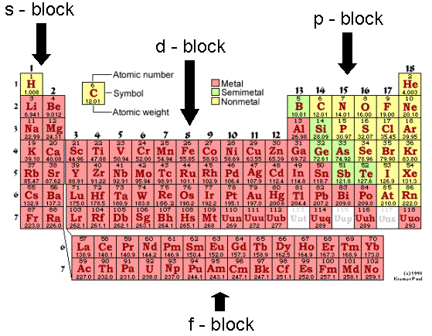
Position of p-block in periodic table

Slide 3
What are p-block elements?
p-block elements are the elements in which the last electron enters ‘np’ orbital which include six groups of elements i.e. group 13 to 18 boron family, carbon family, pnicogens, chalcogens, halogens and noble gases.

Slide 4
General electronic configuration & oxidation state
Group 13 14 15 16 17 18
G.E.C ns²np¹ ns²np² ns²np³ ns²np⁴ ns²np⁵ ns²np6
(1s^{2 for He})
First G. B C N O F He
Element
G.O.S +3 +4 +5 +6 +7 +8
Other +1 +2 +3 +4 +5 +6
O.S -4 -3 +2 +3 +4
-2 +1 +2

Slide 5
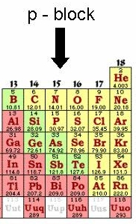
As metals,non-metals and metalloids exist only in p-block of periodic table.
The heaviest element in each
p-block group is mostly
metallic in nature.
Non-metallic character of elements decreases down the group.

Slide 6
Non metals have higher ionization enthalpy and electronegetivity than the metals.
Hence metals form cations, and non metals form anions.
Compounds formed between non metals are largely covalent in nature, while the compounds formed by highly reactive non-metal and metal have large difference in electronegativities.

Slide 7
p-block elements differ…
Size and all the properties of size
because of this the lightest p-block elements show the same kind of differences as the lightest s-block element i.e. lithium and beryllium.
Elements starting from boron are restricted to maximum covalence of four (using 2s and three 2p orbitals).

Slide 8
Group 13 elements: The boron family
Elements At. No. Electronic conf.
B 5 2s²2p¹ (He)
Al 13 3s²3p¹ (Ne)
Ga 31 3d¹⁰4s²4p¹ (Ar)
In 49 4d¹⁰5s²5p¹ (Kr) Tl 81 4f¹⁴5d¹⁰6s²6p¹ (Xe)

Slide 9
Atomic radii
The atomic radii increases from boron to thallium.
Element B Al Ga In Tl
At. radius 88 143 135 167 170
The abrupt increase in atomic radius of Al is due to greater screening effect in Al than B.

Slide 10
Ionization enthalpy
Here the first ionization enthalpies of these elements are less than corresponding value of s-block element.
This is because p-electrons are less penetrating and more shielded than s-electrons.
B Al Ga In Tl
801 577 579 558 589

Slide 11
Electronegetivity
Down the group, electronegetivity first decreases from B to Al and then increases till thallium.
This is because of the difference in atomic sizes of elements.
B Al Ga In Tl
2.0 1.5 1.6 1.7 1.8

Slide 12
Physical properties
Boron is extremely hard and black in colored solid which exists in many allotropic form.
Density:- It increases from B to Tl due to increasing size of atom.
B Al Ga In Tl
Density 2.35 2.70 5.90 7.31 11.85

Slide 13
Metallic character:-The elements of boron family are less metallic or electropositive as compared to group 2.
On moving down the group, the metallic character increases initially from B to Al but decreases from Al to Tl.

Slide 14
Oxidation states:- The elements of boron family have ns²np¹ configuration which means that they have 3 valance electron available for bond formation. By loosing these electrons they are accepted to show +3 oxidation states in there compounds.

Slide 15
Chemical Properties Of Group 13

Slide 16
Introduction
1)Group 13 elements and their uses
2)Boron – Electronic structure
Chemical properties
3)Aluminium- Structure and properties
4) Equations
5) Concluion

Slide 17
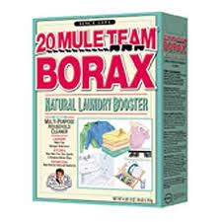
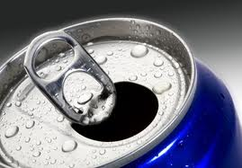
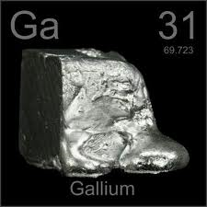
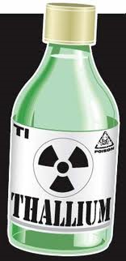
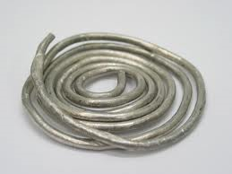
Boron – glasses, ceramics and agriculture
Aluminum – electrical devices and construction materials
Gallium – amplifiers, solar cells and satellites
Indium – coatings and alloys
Thallium – photo electric cell, and toxics

Slide 18
Boron
Electronic structure – 1s² 2s² 2p¹ Atomic radius – 90 pm.
Due to this relatively small size of boron, the sum of its first three ionization enthalpies is very high.
This prevents it to form 3+ ions and forces it to form only covalent compounds.
In the trivalent state, boron can be called as electron deficient as it will have only 6 electrons in its outer most orbit. Thus, Boron has a tendency to accept a lone pair of electrons from another compound to become stable.
This property also makes the compound a Lewis acid.

Slide 19
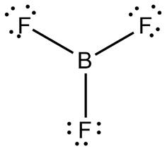
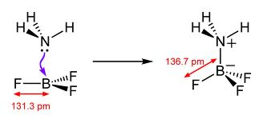
It is unreactive in crystalline form
However, amorphous boron on heating in air forms B203.It reacts with di nitrogen at high temperatures to form nitrides.
B2O3 is acidic and reacts with basic oxides forming metal borates
It does not react with acids and alkanes.

Slide 20
Aluminum and other group 13 elements
Sum of the first three ionization enthalpies is less, as compared to Boron. Thus, it due to the easy tendency to lose electrons It is able to form Al 3+.
In the other elements, due to poor shielding effect of d and f orbitals, the nucleus holds the outer most s electrons tightly. Thus, only p bonding may be available for bonding.
In all 3 elements, both +1 and +3 oxidation states are seen.
The compounds in +1 state are more ionic than those in +3 state.

Slide 21
Aluminum forms a very thin oxide layer. With di nitrogen at high temperatures they form nitrides.
It dissolves in mineral acids and aqueous alkalies and thus show amphoteric character.
All the group 13 elements except thallium show reactivity towards halogens.

Slide 22
2E(s) + 3O₂(g) 2E₂O₃(s)
2E (s) + N₂(g) 2EN(s)
[ E = element ]
2Al(s) + 6HCl (aq) 2Al³⁺⁽aq) + 6Cl⁻(aq) + 3H₂₍g)
2E(s) + 3X₂(g) 2EX₃ (s)

Slide 23
Conclusion
We have learnt the far and wide reaching applications of all the group 13 elements.
We learnt the chemical properties of boron, and aluminium in detail, how they form compounds with other elements their structures; and their reactivity with certain substances.

Slide 24
BORON AND ITS COMPOUNDS

Slide 25
1.Borax
It is the most important compound of boron. It is a white crystalline solid of formula Na2B4O7⋅10H2O. Borax dissolves in water to give an alkaline solution.
Na2B4O7 + 7H2O → 2NaOH + 4H3BO3
Orthoboric acid
On heating, borax first loses water molecules and swells up. On further heating it turns into a transparent liquid, which solidifies into glass like material known as borax bead.
Na2B4O7.10H2O⎯⎯Δ→Na2B4O7⎯⎯Δ →2NaBO2+ B2O3
sodium metaborate

Slide 26
2.Orthoboric acid
Orthoboric acid, H3BO3 is a white crystalline solid, with soapy touch. It is sparingly soluble in water but highly soluble in hot water.
It can be prepared by acidifying an aqueous solution of borax.
Na2B4O7 + 2HCl + 5H2O → 2NaCl + 4B(OH)3
It has a layer structure in which planar BO3 units are joined by hydrogen bonds .
Boric acid is a weak monobasic acid. It is not a protonic acid but acts as a Lewis acid by accepting electrons from a hydroxyl ion:
B(OH)3 + 2HOH → [B(OH)4]– + H3O+

Slide 27
On heating, orthoboric acid above 370K forms metaboric acid , HBO2 which on further
heating yields boric oxide, B2O3.
H3BO3⎯Δ→ HBO2⎯Δ→ B2O3
3.Diborane, B2H6
The simplest boron hydride known, is diborane. It is prepared by treating boron trifluoride with LiAlH4 in diethyl ether .
4BF3 + 3 LiAlH4 → 2B2H6 + 3LiF + 3AlF3
A convenient laboratory method for the preparation of diborane involves the oxidation of sodium boron hydride with iodine
2NaBH4 + I2 → B2H6 + 2NaI + H2
Diborane is produced on an industrial scale by the reaction of BF3 with sodium hydride.
2BF +6NaH ⎯4⎯50K⎯→B H +6NaF

Slide 28
PROPERTIES OF DIBORANE.
1.Diborane is a colourless, highly toxic gas with a b.p. of 180 K.
2.Diborane catches fire spontaneously upon exposure to air. It burns in oxygen releasing an enormous amount of energy.
3.Reaction of ammonia with diborane gives initially B2H6.2NH3 , further heating gives borazine, B3N3H6 known as “inorganic benzene” .

Slide 29
The structure of diborane is shown below . The four terminal hydrogen atoms and the two boron atoms lie in one plane. Above and below this plane, there are two bridging hydrogen atoms. The four terminal B-H bonds are regular two centre-two electron bonds while the two bridge (B-H-B) bonds are different and can be described in terms of three centre two Electron bond.

Slide 30
USES OF BORON AND ALUMINIUM
AND THEIR COMPOUNDS
BORON
Boron has low density and very low electrical conductivity, finds many
applications.
1.Boron fibres are used in making bullet-proof vest and light material for aircraft .
2.The boron-10 isotope has high ability to absorb neutrons and there f metal borides are used in nuclear industry as protective shields and control rods.
3. The main industrial application of borax and boric acid is in the manufacture of heat resistant glasses like glass-wool and fibreglass.
4.Borax is used as a constituent of medicinal soaps. An aqueous solution of orthoboric acid is generally used as a mild antiseptic.

Slide 31
ALUMINIUM
1.Aluminium is a bright silvery-white metal. It has a high electrical and thermal conductivity.
2.It forms alloys with Cu, Mn, Mg, Si and Zn. Aluminium and its alloys can be given shapes of pipe, tubes, rods, wires, plates or foils and, therefore, find uses in packing, utensil making,
construction, aeroplane and transportation industry.
3.The use of aluminium and its compounds for domestic purposes is now reduced considerably because of their toxic nature.

Slide 32
GROUP 14 ELEMENTS

Slide 33
PRESENTATION OVERVIEW
MODERN PERIODIC TABLE
GROUP 14 ELEMENTS: THE CARBON FAMILY
CARBON & ITS USES
SILCON & ITS USES
GERMNIUM & USES
TIN & ITS USES
LEAD & ITS USES
ATOMIC AND PHYSICAL PROPERTIES
CHEMICAL PROPERTIES

Slide 34
GROUP 14 ELEMENTS: THE CARBON FAMILY
Element symbol electron configuration
Carbon C [He]2s²2p²
Silicon Si [Ne]3s²3p²
Germanium Ge [Ar]3d¹⁰4s² 4p²
Tin Sn [Kr]4d¹⁰5s² 5p²
Lead Pb [Xe]4f¹⁴ 5d¹⁰6s² 6p²

Slide 35
Atomic and physical properties: group 14 elements
Property | Elements
 | Carbon | Silicon | Germanium | Tin | Lead
Atomic number | 6 | 14 | 32 | 50 | 82
Atomic mass(g/mol) | 12.01 | 28.09 | 72.60 | 118.71 | 207.2
Electronic configuration | [He]2s²2p² | [Ne]3s²3p² | [Ar]3d¹⁰4s²4p² | [Kr]4d¹⁰5s²5p² | [Xe]4f¹⁴5d¹⁰6s²6p²
Covalent radius/pm | 77 | 118 | 122 | 140 | 146
Ionic radiusM⁴⁺/pm | _ | 40 | 53 | 69 | 78
Ionic radius M²⁺/pm | _ | _ | 73 | 118 | 119
Ionization enthalpy/Kjmol⁻¹ (∆_{i}H) | 1086 | 786 | 761 | 708 | 715
Electronegativity | 2.5 | 1.8 | 1.8 | 1.8 | 1.9
Density/g cm-3 | 3.51 | 2.34 | 5.32 | 7.26 | 11.34
Melting point/K | 4373 | 1693 | 1218 | 505 | 600
Boiling point/K | _ | 3550 | 3123 | 2896 | 2024
Electrical resistivity/ohm cm | 10¹⁴-10¹⁶ | 50 | 50 | 10⁻⁵ | 2 X 10⁻⁵

Slide 36
Chemical properties
Oxidation state:-
Carbon and silicon have +4 oxidation state.
C & Si have very rare +2 compounds.
Ge, Sn & Pb show both +2 and +4 oxidation states.
The +2 state is more stable than +4 state as we go down the group.
Fajan’s rule:- “smaller is the cation, the greater is the covalent character in its compounds”. Eg Sn⁴⁺ compounds are covalent and Sn²⁺ compounds are ionic in nature.

Slide 37
Chemical properties (CONT----)
Catenation:-
The property of self linkage leading to the formation of long chains and rings is termed catenation.
Carbon has a greater tendency of self linking than other elements.
Catenation tendency follows follows the order,
C >> Si > Ge ≈ Sn >> Pb
Since, the M─M bond enthalpy decreases steadily from C to Sn. Therefore, the catenation tendency also decreases down the group.
Bond | C─C | Si─Si | Ge─Ge | Sn─Sn
Bond enthalpy (Kjmol⁻¹) | 348 | 222 | 167 | 155

Slide 38
Chemical properties (CONT----)
Formation of multiple bonds :- pi bonding
Carbon forms stable multiple bonds with itself and with other elements.
>C=C< ─C≡C─ >C=O >C=N ─C≡N >C=S
Other elements of this group show no tendency to form pi bonds.
However a few compounds containing multiple bonds have been isolated.
Effect of pi bonding on the structure may be seen in graphite.

Slide 39
Chemical properties (CONT---)
Hydride formation:-
Covalent hydrides of the type MH₄ are known for all group 14 elements except lead.
Tendency of hydride formation decreases in going from C to Pb.
Carbon forms a large number of cyclic and acyclic hydrides known as hydrocarbons.
Silicon and germanium form fewer hydrides of the general formula Si_{n}H_{2n+2} & Ge_{n}H_{2n+2} known as silanes and germanes respectively..

Slide 40
Chemical properties (CONT---)
Oxide formation:-
Group 14 elements form three types of oxides:-
MO(monoxide) MO₂(Dioxide) M₂O₃(MO+MO₂)(Mixed oxide)
All elements of group14 expect silicon form monoxides of the formula MO.
While CO is neutral, all other oxides are basic in character.
Carbon monoxide(CO) is the most important monoxide.
All group14 elements form dioxides having the formula MO₂.
These oxides differ in their properties and structures.

Slide 41
Chemical properties (CONT---)
Halide formation:-
Elements of group14 form the following types of halides,
MX₄ type eg., CCL₄ (carbon tetrachloride)
MHX₃ type eg., CHCL₃ (Chloroform)
MX₂ type eg., SICL₂ (Silicon dichloride)
Dihalides of Ge, Sn & Pb are more ionic in nature.
The stability of dihalides increases in going down the group
Tetrahalides of the type MX₄ are known for all the elements of group14.
Tetrahalides are tetradedral and covalent.
The tetrahalides of all elements except of carbon undergo hydrolysis.

Slide 42
CARBON
Introduction
Symbol :-C.
Latin word:- "carbo" meaning"charcoal"
Atomic Number = 6, Atomic Mass = 12.01
Most common element: graphite, diamonds and coal.
Most common compounds:- Hydrocarbons and Carbon dioxide.
Physical Properties
Carbon is a soft, dull gray or black non-metal that can be scratched with a fingernail.
The density of carbon as graphite is 2.267 g/mL, which means it will sink in water.

Slide 43
CARBON-Uses
Diamond
Jewellery
Manufacturing tools
In making dies
Graphite
Lubricant at high temperature
Manufacturing lead pencils
Coal
Fuel
Manufacturing coal tar, coke and coal gas
Manufacturing synthetic petrol

Slide 44
SILICON
Introduction
Symbol :-Si.
Latin word:- “Silicium”
Atomic Number = 14, Atomic Mass = 28.09
Most common compounds:-Silicon dioxide (SiO₂),Silicon carbide (SiC),Sodium silicate (Na₂SiO₃) and Silicon tetrachloride (SiCl₄)
Physical Properties
Crystalline silicon has a metallic grayish color
Silicon is relatively inert, but it is attacked by dilute alkali and by halogens
Silicon transmits over 95% of all infrared wavelengths (1.3-6.7 mm)

Slide 45
SILICON-Uses
Electronic devices such as transistors, diodes and chips
For producing ferrosilicon
As a deoxidiser in steal industry
Important to plant and animal life

Slide 46
GERMANIUM
Introduction
Symbol :-Ge
Latin word:- “Germania”
Atomic Number = 32, Atomic Mass = 72.60
Most common compounds:- Oxide(s): GeO, GeO₂ Chloride(s): GeCl₂, GeCl₄ , Hydride(s): GeH₄, Ge₂H₆
Physical Properties
Germanium is a lustrous, hard, gray-white semi-metallic element
Germanium expands as it freezes
It is a semiconductor
Germanium and the oxide are transparent to infrared radiation

Slide 47
GERMANIUM-Uses
Semiconductor devices
Making prisms, lenses and windows in instruments based on IR
As catalyst

Slide 48
TIN
Introduction
Symbol :-Sn
Latin word:- “Stannum”
Atomic Number = 50, Atomic Mass = 118.69
Most common compounds:-SnF₄, Sncl₄, Snbr₄ and SnCl₂
Physical Properties
Tin is a malleable silvery-white metal which takes a high polish
It possesses a highly crystalline structure and is moderately ductile.
When a bar of tin is bent, the crystals break, producing a characteristic 'tin cry‘.
Tin has a cubic structure.
Upon warming, at 13.2°C gray tin changes to white

Slide 49
TIN-Uses
For tinning of copper and brass utensils
For making tin foils for wrapping cigarettes
For making alloy:- solder, bronze and gun metal
Sno₂ coated glass is scratch resistant i.e. aircraft windows
Used in agriculture to control fungi such as potato blight

Slide 50
LEAD
Introduction
Symbol :-Pb
Latin word:- “plumbum”
Atomic Number = 82, Atomic Mass = 207.19
Most common compounds:- PbCl₂ ,PbO₂ ,Pb(NO₂)₂ ,Pb₃O₄ ,Pb(CH₃)₄
Physical Properties
Lead is a soft, malleable and poor metal
It is also counted as one of the heavy metals
Metallic lead has a bluish-white color after being freshly cut, but it soon tarnishes to a dull grayish color when exposed to air
Lead has a shiny chrome-silver luster when it is melted into a liquid

Slide 51
LEAD-Uses
For making water pipes
Lead storage battery
For making bullets, shots, etc
Alloys:- solder
Used for preparing high refractive index glasses

